Slide 1


Basic Programming using C++
by Aqilah Rose

Slide 2
“Your best quote that reflects your approach… “It’s one small step for man, one giant leap for mankind.”
- Neil Armstrong

Slide 3
Outline
Introduction
Basic
C++ features
C++
Compiler
First Program
Hello world
Variables &
their types
Data
Types
Operators
in C++
Control Statement
Functions
Functions
in c++
Default
Arguments
C++
Recursion
If, if..else-if
Switch case in C++
Array
For Loop
While Loop
1D N 2D
Passing
Array to fc
C++ Strings
Do While Loop
Continue Statement
Pointers
Break Statement
goto statement
Pointers in C++
this pointer

Slide 4
Outline (Cont.)
Object Oriented Programming (OOP) Concept
OOP Concepts
Constructor
Destructor
Structure
How to Pass & return struct from function
Enumeration
Inheritance
Polymorphism
Function Overloading
Function Overriding
Virtual Function: Run time Polymorphism
Encapsulation
Abstraction
Interfaces-Abstract Class
Pass & Return Obj from Fc
Friend Class & Function

Slide 5
Functions
Functions
Functions
in c++
Default
Arguments
C++
Recursion

Slide 6
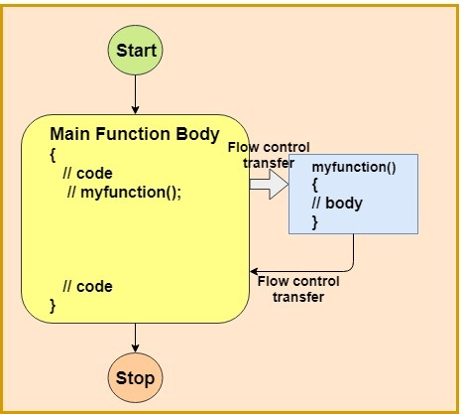

Slide 7
What is function?
A function is block of code which is used to perform a particular task, for example let’s say you are writing a large C++ program and in that program you want to do a particular task several number of times, like displaying value from 1 to 10, in order to do that you have to write few lines of code and you need to repeat these lines every time you display values.
Another way of doing this is that you write these lines inside a function and call that function every time you want to display values. This would make you code simple, readable and reusable.

Slide 8
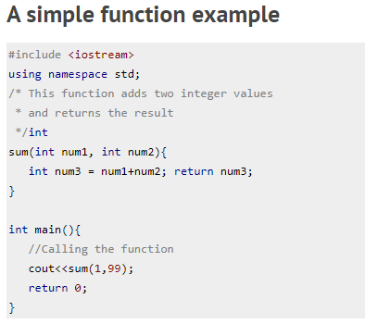

Syntax Functions

Slide 9
Function Declaration
The same program can be code in two ways:
The thing is that when you define the function before the main() function in your program then you don’t need to do function declaration
if you are writing your function after the main() function like we did in the second program then you need to declare the function first, else you will get compilation error.

Slide 10
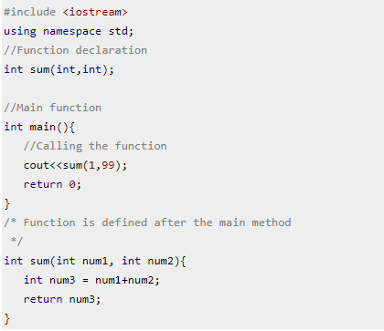
Why do you think we need this f(x) declaration?
Before main()
after main()

Slide 11
Syntax & how to call function?
Syntax of function declaration: return_type function_name(parameter_list);
Note: While providing parameter_list you can avoid the parameter names, write int sum(int,int); instead of int sum(int num1,int num2).
Function definition: Writing the full body of function is known as defining a function.
syntax of function definition:
return_type function_name(parameter_list) {
//Statements inside function
}

Slide 12
Calling function: We can call the function like this:
function_name(parameters);

Slide 13
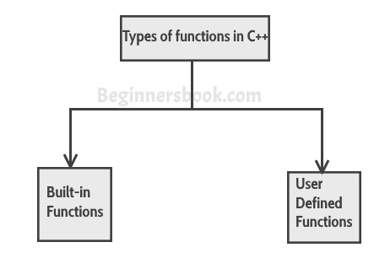
Types of function
We have two types of function in C++:

Slide 14
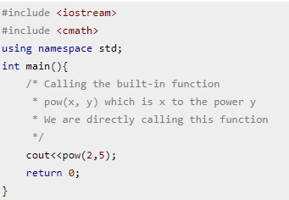
Build-it functions
Built-in functions are also known as library functions. We need not to declare and define these functions as they are already written in the C++ libraries such as iostream, cmath etc. We can directly call them when we need.
example: C++ built-in function example:
Here we are using built-in function pow(x,y) which is x to the power y.
This function is declared in cmath header file so we have included the file in our program using #include directive.

Slide 15
User-defined functions
We have already seen user-defined functions, the example we have given at the beginning of this tutorial is an example of user-defined function.
The functions that we declare and write in our programs are user-defined functions.

Slide 16
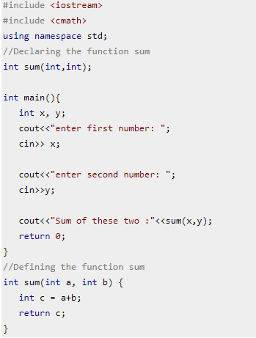

Slide 17
Default Arguments in C++ Functions
The default arguments are used when you provide no arguments or only few arguments while calling a function. The default arguments are used during compilation of program.
For example, lets say you have a user-defined function sum declared like this: int sum(int a=10, int b=20), now while calling this function you do not provide any arguments, simply called sum(); then in this case the result would be 30, compiler used the default values 10 and 20 declared in function signature.
If you pass only one argument like this: sum(80) then the result would be 100, using the passed argument 80 as first value and 20 taken from the default argument.

Slide 18
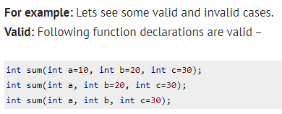
Rules of default arguments
It is up to you to assign default values to all arguments or only selected arguments but remember the following rule while assigning default values to only some of the arguments:
If you assign default value to an argument, the subsequent arguments must have default values assigned to them, else you will get compilation error.

Slide 19
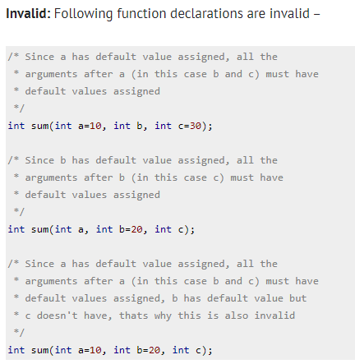

Slide 20
C++ Recursion
The process in which a function calls itself is known as recursion and the corresponding function is called the recursive function. The popular example to understand the recursion is factorial function.
Factorial function: f(n) = n*f(n-1), base condition: if n<=1 then f(n) = 1. Don’t worry we wil discuss what is base condition and why it is important.
In the following diagram. I have shown that how the factorial function is calling itself until the function reaches to the base condition.

Slide 21
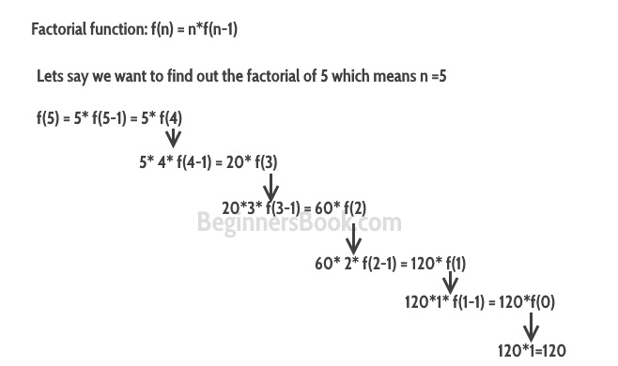

Slide 22
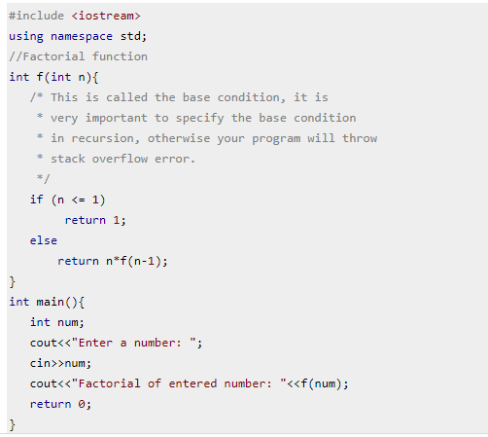
C++ recursion example: Factorial
The purpose of recursion is to divide the problem into smaller problems till the base condition is reached.
The example solving the factorial function f(n) by calling a smaller factorial function f(n-1), this happens repeatedly until the n value reaches base condition(f(1)=1).
If you do not define the base condition in the recursive function then you will get stack overflow error.

